Slide 1
Robotics 1
Robot components:
Actuators
1

Slide 2
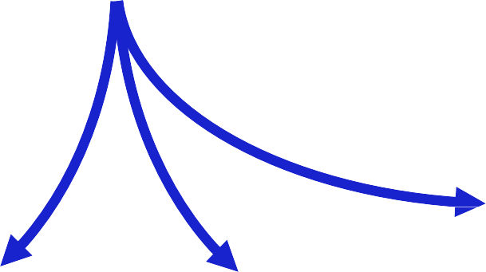








Robot as a system
commands
Robot
actions
program of tasks
working environment
mechanical units
supervision units
sensor units
actuation units
2

Slide 3
Functional units of a robot
mechanical units (robot arms)
rigid links connected through rotational or prismatic joints (each 1 dof)
mechanical subdivisions:
supporting structure (mobility), wrist (dexterity), end-effector (task execution, e.g., manipulation)
sensor units
proprioceptive (internal robot state: position and velocity of the joints)
exteroceptive (external world: force and proximity, vision, …)
actuation units
motors (electrical, hydraulic, pneumatic)
motion control algorithms
supervision units
task planning and control
artificial intelligence and reasoning
3

Slide 4

Actuation systems
power supply
P = types of powers in play
electrical, hydraulic, or pneumatic
mechanical
P_{p}
P_{c}
power amplifier
P_{a}
servomotor
P_{m}
transmission
(mechanical gears)
P_{u}
^{P}da
^{P}ds
^{P}dt
electrical
power losses due to dissipative effects (e.g., friction)
power = force · speed = torque · angular speed [Nm/s, W] efficiency = power out / power in [%]
Robotics 1
4

Slide 5
Motion transmission gears
optimize the transfer of mechanical torque from actuating motors to driven links
quantitative transformation (from low torque/high velocity to high torque/low velocity)
qualitative transformation (e.g., from rotational motion of an electrical motor to a linear motion of a link along the axis of a prismatic joint)
allow improvement of static and dynamic performance by reducing the weight of the actual robot structure in motion (locating the motors remotely, closer to the robot base)

Slide 6
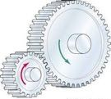
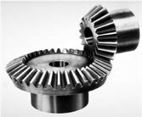
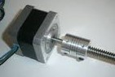
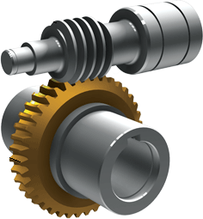
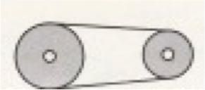
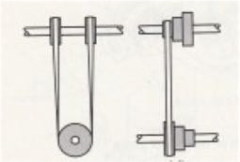
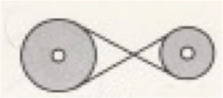
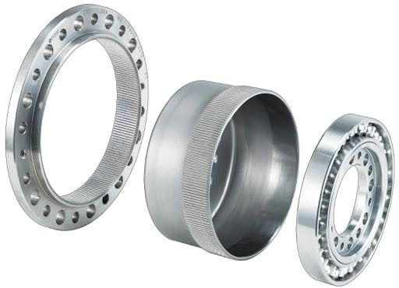
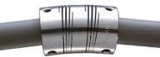
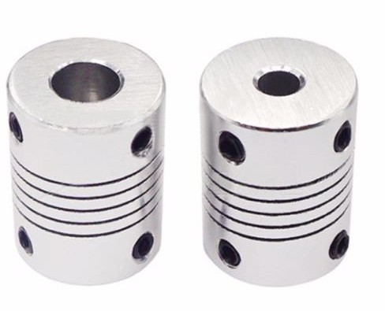
Transmissions in robotics
spur gears: modify direction and/or translate axis of (rotational or translational) motor displacement
problems: deformations, backlash
lead screws, worm gearing: convert rotational into translational motion (prismatic joints)
problems: friction, elasticity, backlash
toothed belts and chains: dislocate the motor
w.r.t. the joint axis
problems: compliance (belts) or vibrations induced by larger mass at high speed (chains)
harmonic drives: compact, in-line, power efficient, with high reduction ratio (up to 150-200:1)
problems: elasticity
transmission shafts: long, inside the links, with flexible couplings for alignment

Slide 7
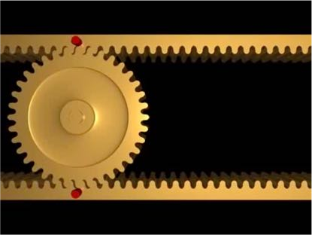
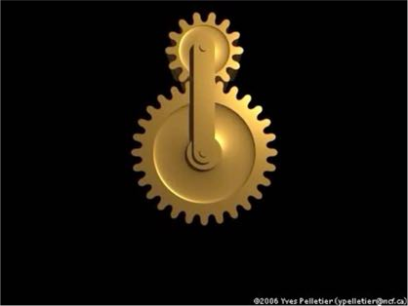
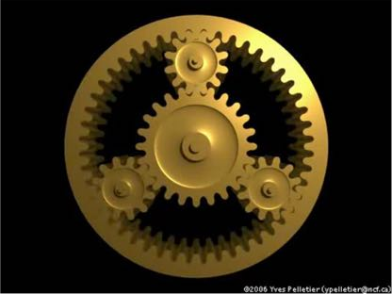
Transmission gears in motion
racks and pinion
one rack moving (or both)
video
epi-cycloidal gear train
or hypo-cycloidal (small gear inside)
video
planetary gear set
one of three components is locked: sun gear, planet carrier, ring gear
video

Slide 8
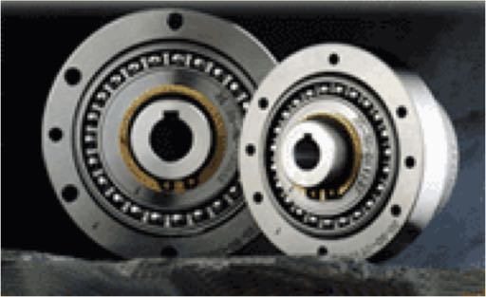
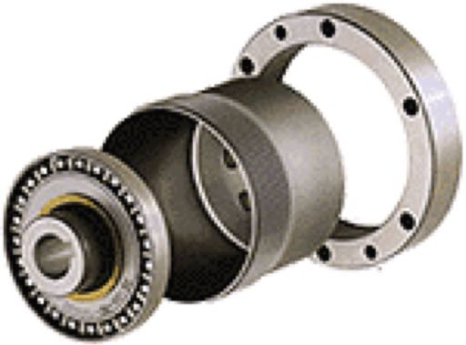
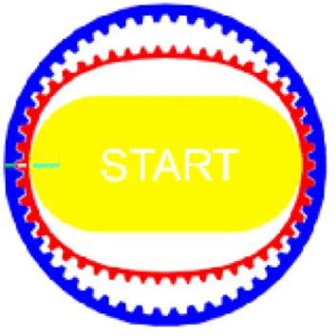
Harmonic drives
Wave Generator (C) of slightly elliptic external form
(with ball bearings)
Circular Spline (A)
inner #teeth CS = outer #teeth FS + 2 reduction ratio
n = #teeth FS / (#teeth CS - #teeth FS)
= #teeth FS / 2
FlexSpline (B) (two contact points)
input from motor
output to load

Slide 9
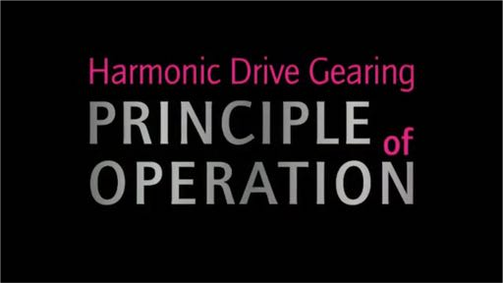
Operation of an harmonic drive
commercial video by Harmonic Drives AG

Slide 10
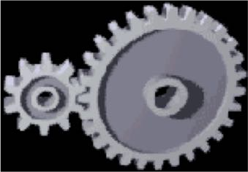


Optimal choice of reduction ratio
P_{m} P_{u}
transmission gear
motor
link
ideal case (no friction)
^{P}dt
power dissipated by friction
. .
P_{m} = T_{m} θ_{m} = T_{u} θ_{u} = P_{u}
torque × angular speed
n = reduction ratio (≫1)
. .
θ_{m} = n θ_{u} T_{u} = n T_{m}
.. ..
to have θ_{u} = a (thus θ_{m} = n a), the motor should provide a torque
.. ..
T_{m} = J_{m} θ_{m} + 1/n (J_{u} θ_{u}) = (J_{m} n + J_{u} /n) a
inertia × angular acceleration
for minimizing T_{m}, we set: ^{∂Tm} = (J_{m} - J_{u} /n²) a = 0
∂n
“matching” condition between inertias
n = (J_{u} / J_{m})^{1/2}

Slide 11
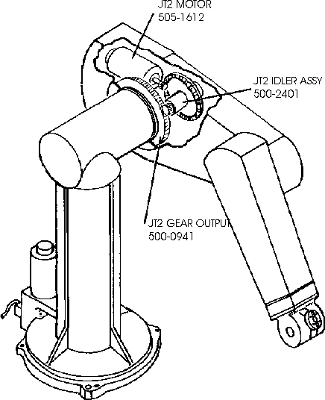
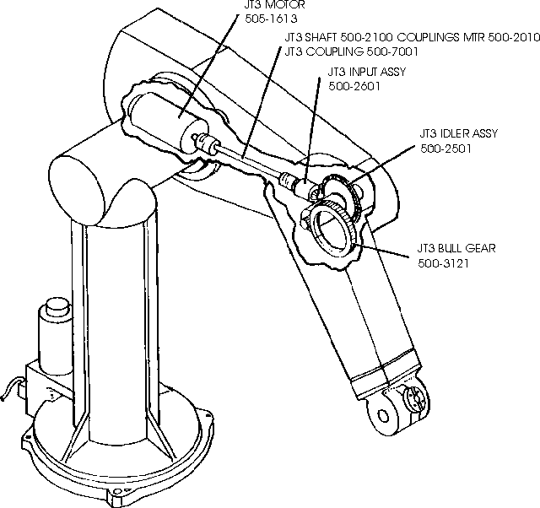
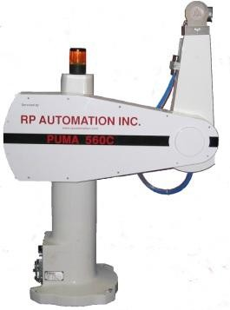
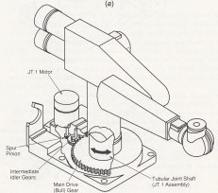
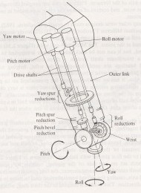
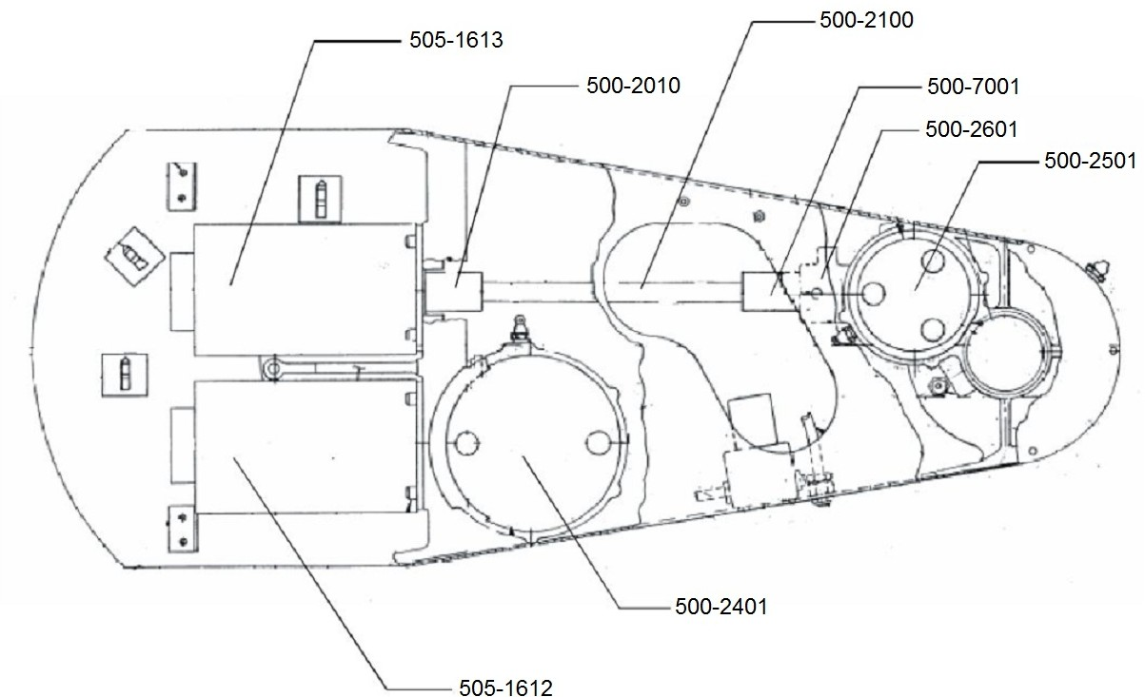
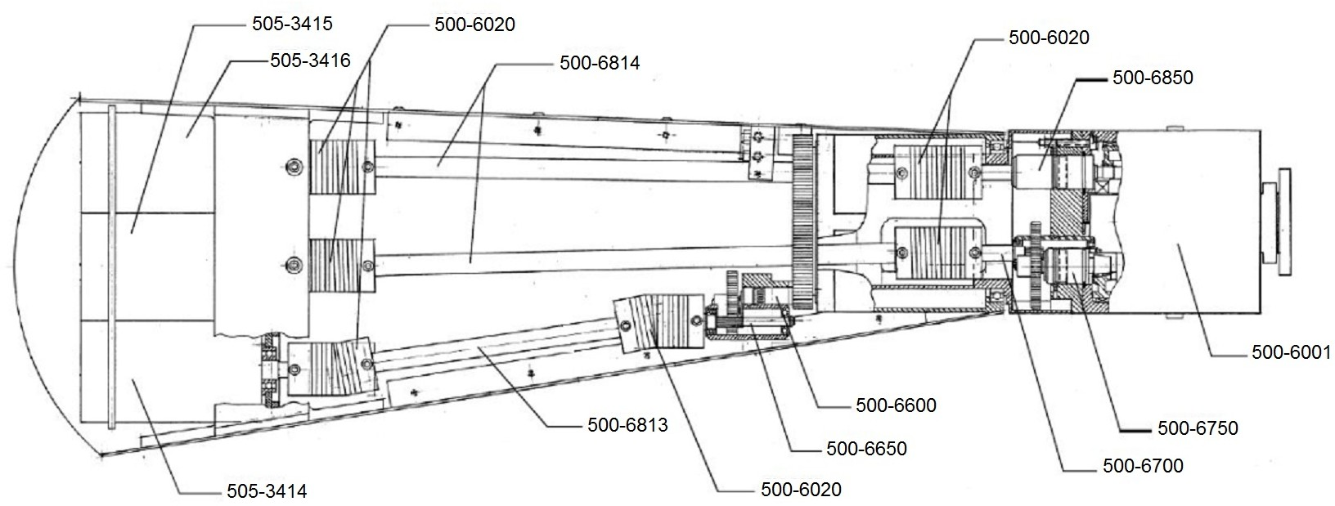
Transmissions in industrial robots
transmissions used (inside) 6-dof Unimation industrial robots with serial kinematics
PUMA 560
PUMA 260: 1st axis
PUMA 560: 2nd and 3rd axes
PUMA 560: inner and outer links
PUMA 560: last 3 axes
Robotics 1
11

Slide 12
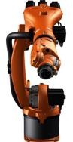
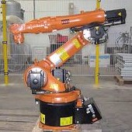
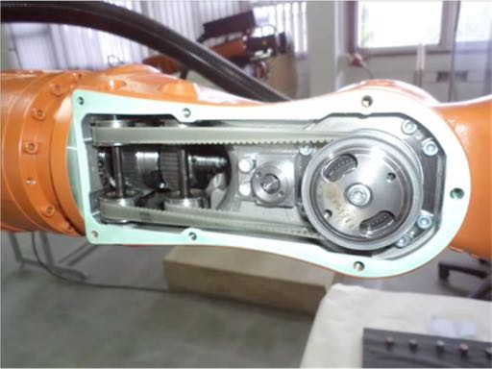
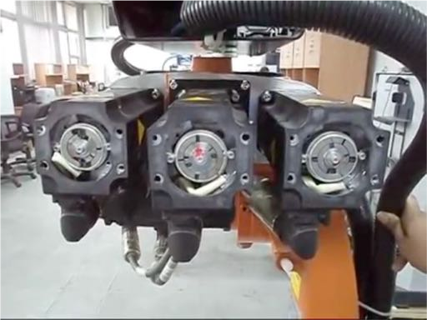
Inside views on joint axes 4, 5 & 6 of an industrial KUKA robot
looking inside the forearm to see the transmissions of the spherical wrist
motor rotation seen from the encoder side (small couplings exist)
Robotics 1
video
video
12

Slide 13
Desired characteristics for robot servomotors
low inertia
high power-to-weight ratio
high acceleration capabilities
variable motion regime, with several stops and inversions
large range of operational velocities
1 to 2000 rpm (round per min)
high accuracy in positioning
at least 1/1000 of a turn
low torque ripple
continuous rotation at low speed
power: 10W to 10 kW

Slide 14
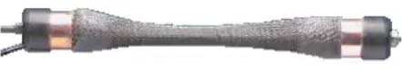
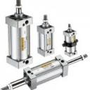
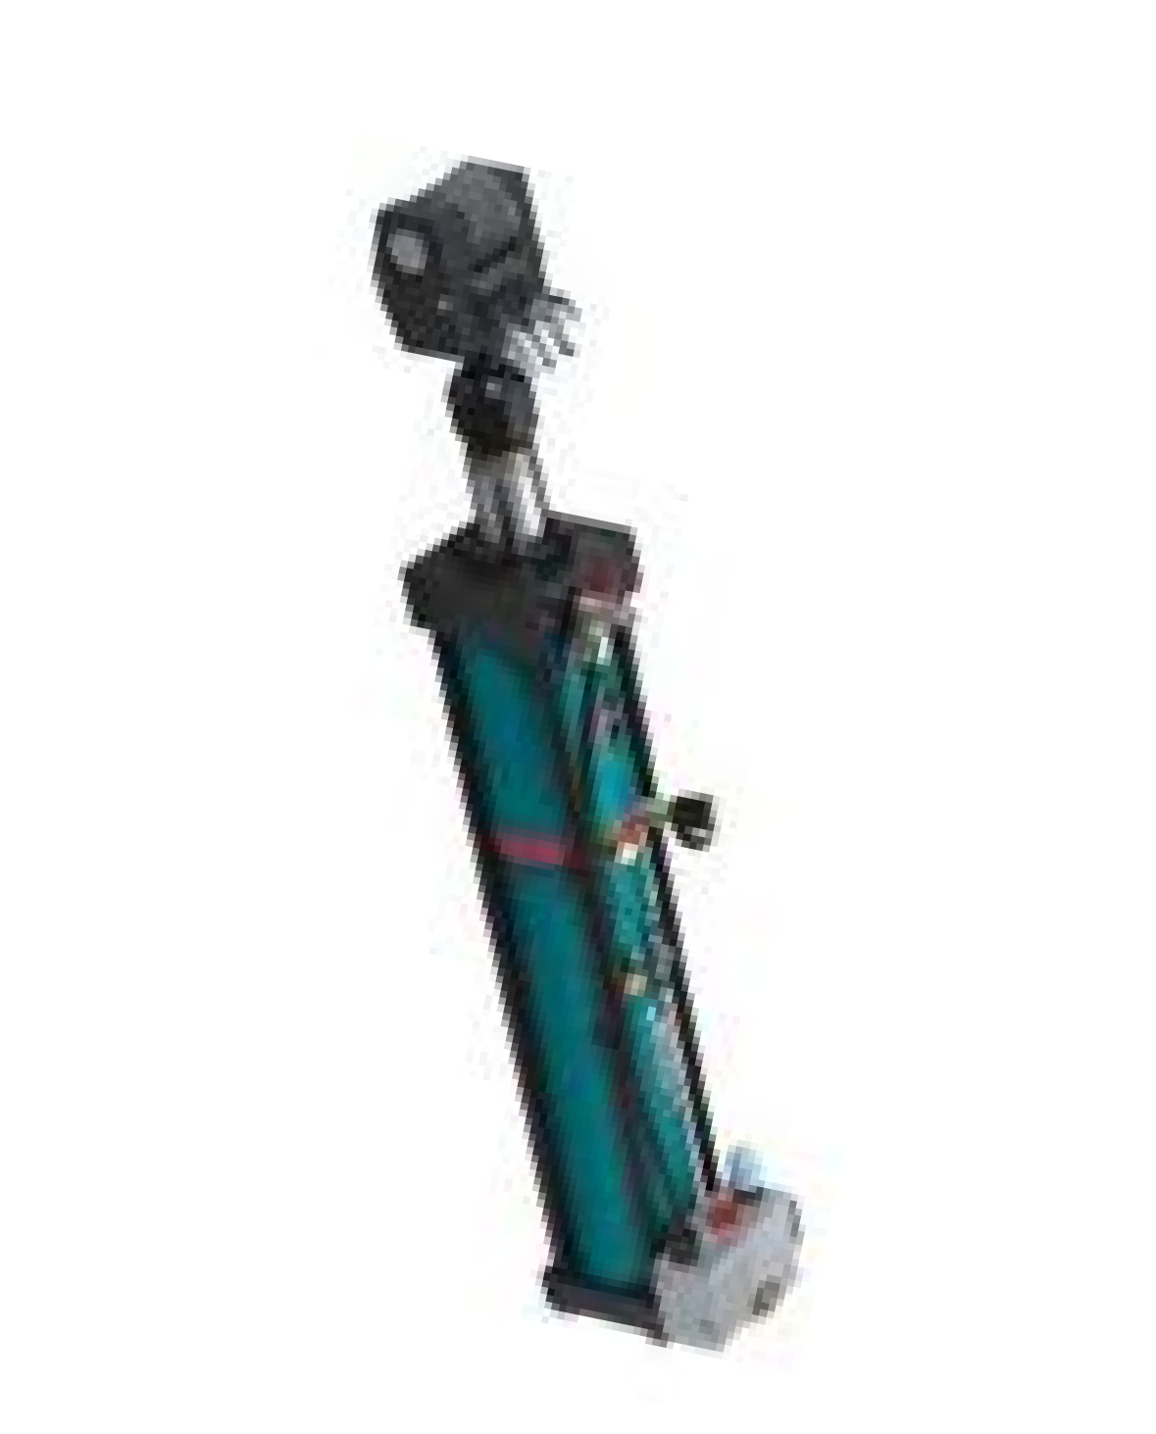




Servomotors
pneumatic: pneumatic energy (compressor) →
pistons or chambers → mechanical energy
difficult to control accurately (change of fluid compressibility) → no trajectory control
used for opening/closing grippers
... or as artificial muscles (McKibben actuators)
hydraulic: hydraulic energy (accumulation tank)
→ pumps/valves → mechanical energy
advantages: no static overheating, self-lubricated, inherently safe (no sparks), excellent power-to-weight ratio, large torques at low velocity (w/o reduction)
disadvantages: needs hydraulic supply, large size, linear motion only, low power conversion efficiency, high cost, increased maintenance (oil leaking)

Slide 15
Electrical servomotors
advantages
power supply available everywhere
low cost
large variety of products
high power conversion efficiency
easy maintenance
no pollution in working environment
disadvantages
overheating in static conditions (in the presence of gravity)
use of emergency brakes
need special protection in flammable environments
some advanced models require more complex control laws

Slide 16
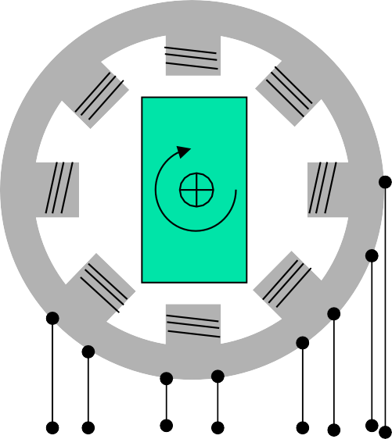


Electrical servomotors for robots
stator (permanent magnets)
stator
collector
brushes
rotor (main motor inertia)
θ
V₁ V₂ V_{n}
switching circuit
armature circuit
V_{a}
V
a
direct current (DC) motor
with electronic switches (brushless)

Slide 17


Advantages of brushless motors
reduced losses, both electrical (due to tension drops at the collector-brushes contacts) and mechanical (friction)
reduced maintenance (no substitution of brushes)
easier heat dissipation
more compact rotor (less inertia and smaller dimensions)
… but indeed a higher cost!

Slide 18
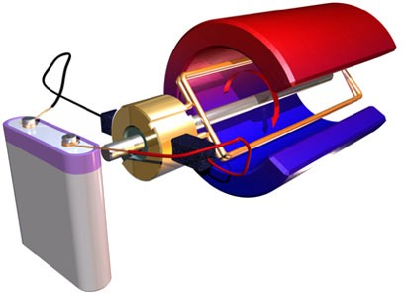
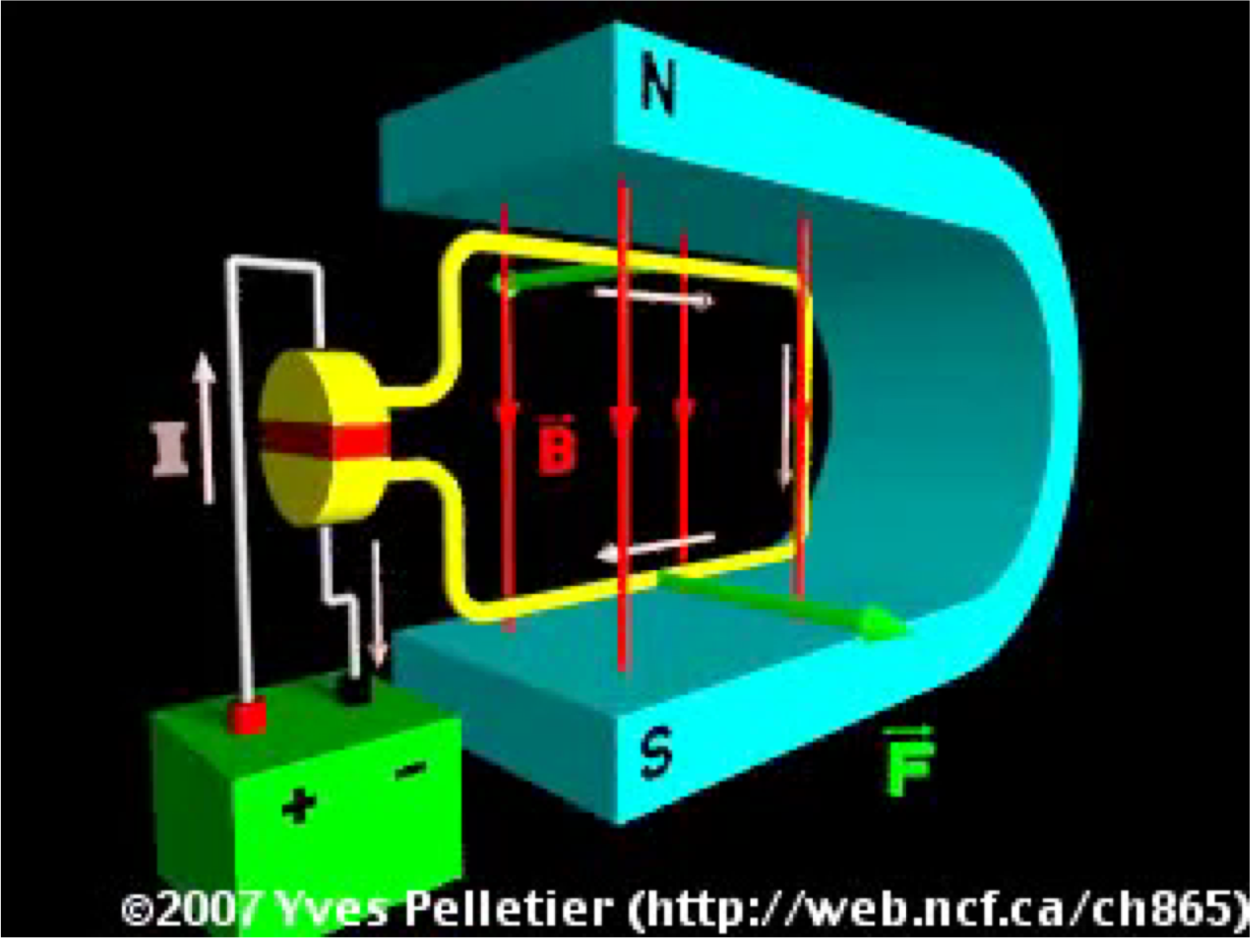
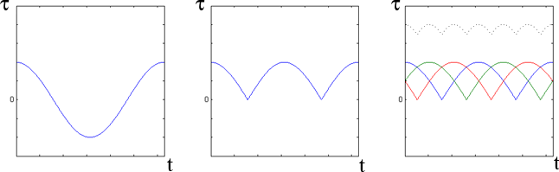
Principle of operation of a DC motor
permanent magnets N-S
single coil (armature)
commutator ring (to switch direction
of armature current every half round)
video
DC supply
V_{a}
"⃗ = $ %⃗ × ' ( = ) "⃗
1 pole pair ...
... + commutator multiple pole pairs
T
T
T
less torque ripple!

Slide 19
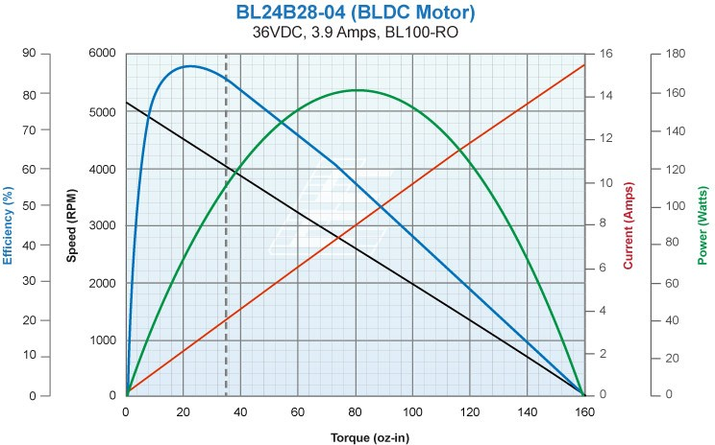
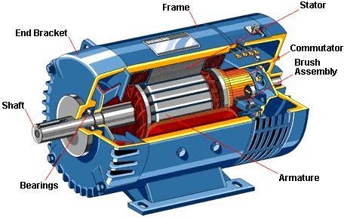
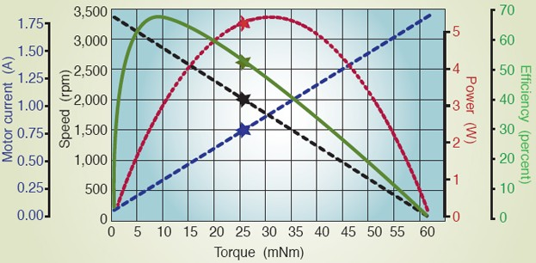
Characteristic curves of a DC motor
at steady-state, for constant applied tension V_{a}
stall current
no-load max speed
medium size motor 160W
rated operating point
stall load torque
conversion SI ⇔ US unit systems (!!)
1 Nm = 141.61 oz-in
100 oz-in = 0.70 Nm
small size motor 5.5W

Slide 20









DC electrical motor
mathematical model for command and control
electrical balance
Laplace domain (transfer functions)
mechanical balance
V_{a} = (R_{a} + sL_{a}) I_{a} + V_{emf}
V_{emf} = k_{v} Ω (back emf)
current loop
T_{m} = (sI_{m} + F_{m}) Ω + T_{load}
T_{m} = k_{t} I_{a}
k_{v} = k_{t}
(energy balance, in SI units!)
k_{i}
I
T
load
V_{a}
+
a
V’
−
V_{c}
G
T_{m}
-
1
Ω
θ
c
+
C_{i}(s)
v
1+sT_{v}
1
k
1
sL_{a}
t
+
-
sI_{m}
s
- -
k_{i} = 0 → velocity generator* k_{i} C_{i}(0) G_{v} ≫ R_{a} → torque generator*
R_{a}
F_{m}
^{V}emf
k
* = the motor is seen here as a steady state “generator”; to actually regulate velocity or torque in an efficient way against T_{load}, further control loops are needed!
v
DC motor

Slide 21
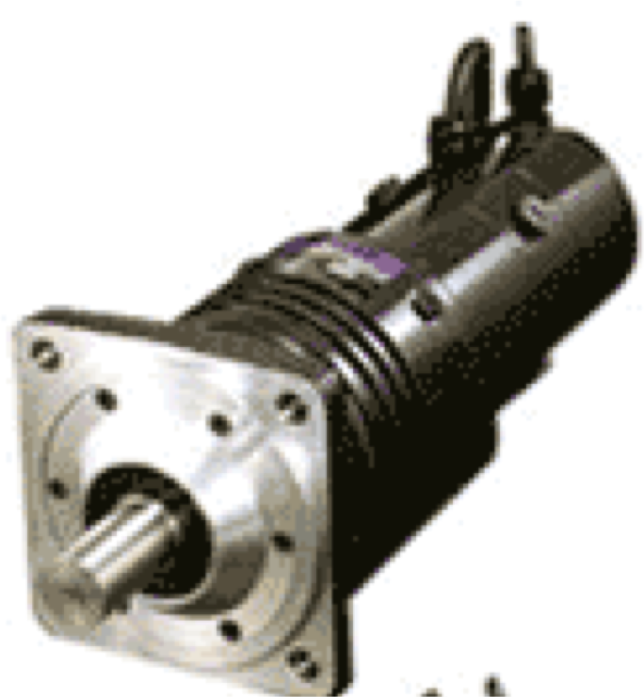
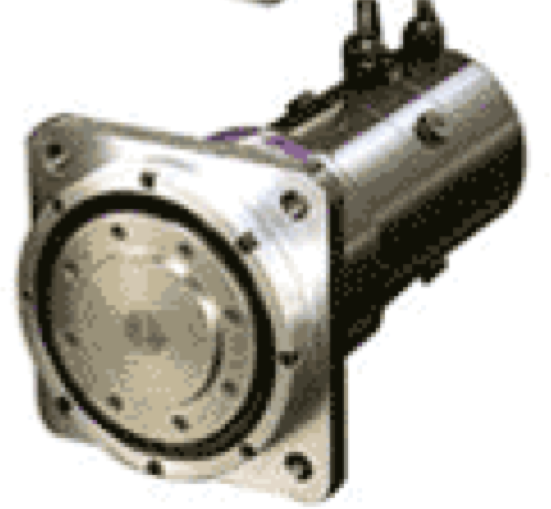
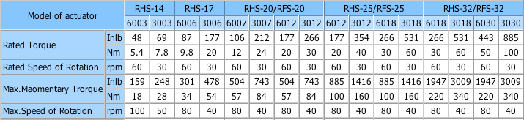
Data sheet electrical motors
DC drives
Max. Instant. Torque
nominal/peak torques and speeds

Slide 22
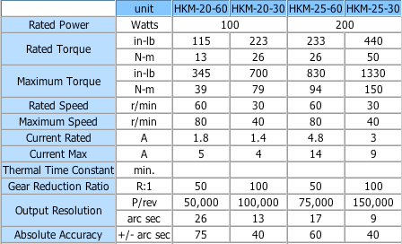
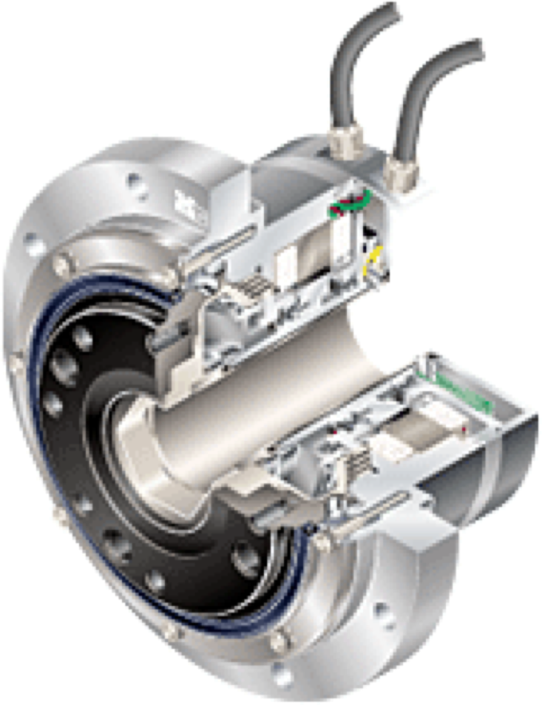
Data sheet electrical motors
AC drives
for applications requiring a rapid and accurate response (in robotics!)
induction motors driven by alternate current (AC)
small diameter rotors, with low inertia for fast starts, stops, and reversals

Slide 23
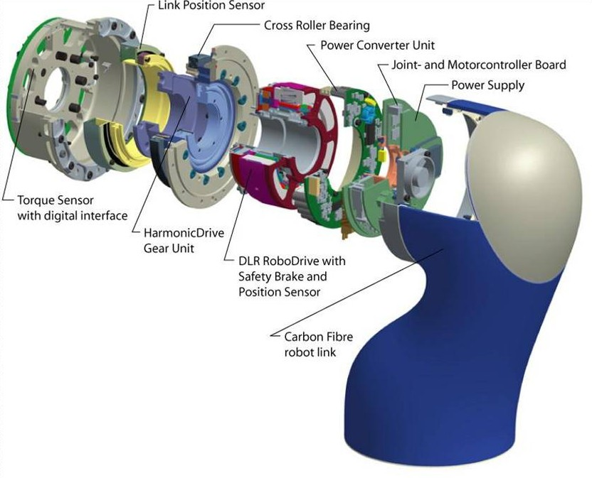
Exploded view of a joint
in the DLR-III robot
"
joint torque
$% = #(! − ")
stiffness #
!

